Slide 1

WEB Programming FUNDAMENTALS
Introduction to HTML
Khurram Raheel

Slide 2
HTML TAGS ESSENTIALS
<h1> This is a heading </h1>
Tag starts from here
Tag ends here

Slide 3

EACH TAG RENDERS SOMETHING DIFFERENT
<img src=“cat.jpg” /> <h1>My Heading</h1>
My Heading

Slide 4
EACH TAG RENDERS SOMETHING DIFFERENT
<img src=“cat.jpg” /> <h1>My Heading</h1>
My Heading

Slide 5


Links
Link tag is used to connect multiple files together
My file.html
Students.html
My photo.jpg

Slide 6
Links
<link href=“target file path”> Content to be displayed to the user</a>
href(An attribute used to specify a connection file)
A path can be absolute or relative
target(An attribute used to specify where the file should open)
_self
_top
_blank

Slide 7
Understanding paths
Nested directories /pc/images/forest/walll1.jpg
Outside directories ../../images/forest.jpg

Slide 8
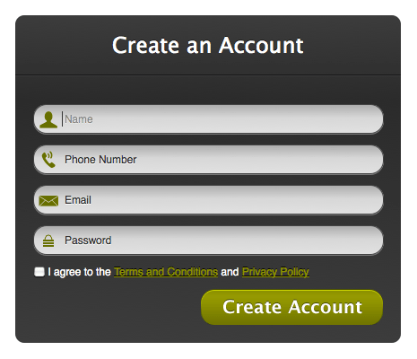
FORMS
FORM is a collective concept used to collect data from a user and the process it.

Slide 9
FORMS
We can take following type of inputs from a user
Password
Text
Date
Email
File
Number
Color
Radio
Checkbox And Many more….!

Slide 10

But how to create a form?
<form>
</form>

Slide 11
But how to create a form?
Where will the form be submitted
<form action=“/login.php”>
</form>

Slide 12
But how to create a form?
Where will the form be submitted
Which submission type
will be used for sending
data. Possible Options GET POST DELETE PUT
<form action=“/login.php” method=“GET”>
</form>

Slide 13

Too many radio buttons is a terrible idea!

Slide 14


If you are having more than 3 options
Its better to use
<select> tag

Slide 15
Today’s Assignment
Create a signup form with table. Ask for the following fields from the user:
Username Password Gender Cities (Long List) Degree Program (Long List) Send the acquired data to the following URL “signup.aspx”

